Slide 1

Reassessing cookie regulation: insights from the EU Consumer Law fitness check on digital fairness
Marco Scialdone
Head of litigation and academic outreach
Euroconsumers

Slide 2


Slide 3
Introduction
Cookies are central to how the digital economy functions. They allow businesses to track user behavior, serve personalized content, and optimize the online experience. However, concerns have grown over their use, especially regarding consumer privacy and data protection
Today, we will explore key findings from the EU Consumer Law Fitness Check and assess how current cookie regulations align with the principles of digital fairness. We’ll discuss regulatory challenges, enforcement gaps, and opportunities for improvement

Slide 4
EU Digital Fairness Framework
The Fitness Check focuses on three key directives governing consumer protection:
  Unfair Commercial Practices Directive (UCPD)
  Consumer Rights Directive (CRD)
  Unfair Contract Terms Directive (UCTD)
These directives aim to protect consumers from deceptive or unfair practices, both online and offline. In the digital context, cookies fall under these rules when used to influence consumer choices, especially in advertising and data collection

Slide 5
The Role of Cookies in Digital Markets
Cookies play a critical role in driving the digital economy by:
  Enabling targeted advertising
  Supporting personalized content and recommendations
  Collecting user data to improve services
From a business perspective, cookies help create value through data-driven decision-making. However, from a consumer’s perspective, the trade-off involves potential privacy risks and reduced control over personal data (the 2023 CCS – Consumer Survey by Eurostat found that 57% of consumers continue to be concerned about installation of cookies)

Slide 6
Digital Fairness: Key Concerns
The Fitness Check identifies several issues related to cookies:
  Dark Patterns: many websites use confusing or manipulative cookie consent mechanisms, leading consumers to unknowingly agree to data tracking.
  Unclear Information: cookie banners often lack clarity, offering limited transparency on how data will be used.
  Consumer Complaints: the number of complaints related to data privacy has increased, especially regarding cookie consent practices.
Consumers are often unaware of how their data is collected, leading to mistrust in online services.

Slide 7
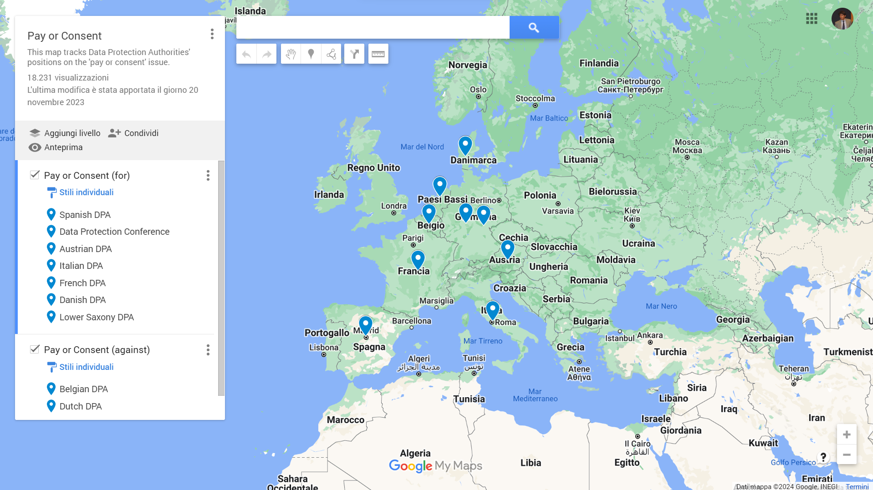
Pay or consent (Pay or ok)

Slide 8
Legal Challenges in Cookie Regulation
There are significant legal challenges in cookie regulation:
  Regulatory Complexity: Cookies are regulated by both the General Data Protection Regulation (GDPR) and the ePrivacy Directive.
  Enforcement Gaps: Differences in enforcement across Member States lead to inconsistent application of cookie rules, undermining consumer trust.
The lack of harmonization and clarity increases both business compliance costs and consumer frustration.

Slide 9
Fitness Check Findings on Consumer Protection
The Fitness Check highlights several key findings:
  Despite various efforts, progress has been slow in improving consumer protection related to cookies.
  Many consumers remain unaware of their rights when it comes to cookie consent and data privacy.
  Data from the Fitness Check shows that while digital participation is growing, consumer awareness of their rights in the digital environment remains low, with only 28% showing sufficient knowledge.
  The findings of the Fitness Check suggest that the growing mismatch between the normative abstraction of the ‘average consumer’ and the realities of consumer behaviour in the digital environment undermines the effectiveness of EU consumer law

Slide 10
Insights on Compliance and Enforcement
The Fitness Check also identifies problems related to compliance:
  High compliance costs for businesses, particularly SMEs, when implementing cookie consent mechanisms.
  Despite these efforts, there is limited reduction in consumer detriment, especially in areas related to data privacy and transparency.
  Inconsistent enforcement makes it difficult for businesses to ensure compliance and for consumers to exercise their rights uniformly across the EU.

Slide 11
Technological Developments and Emerging Needs
As digital technology evolves, new challenges arise:
  AI-driven personalization and the growing Internet of Things (IoT) make cookie regulation even more complex.
  Emerging practices like algorithmic targeting and virtual assistants heavily rely on cookies for data collection and personalization.
To ensure digital fairness, regulations need to be updated to reflect these developments and protect consumers from new risks.

Slide 12
The failure of the cookie pledge (1/2)
in 2023-2024 the Commission facilitated stakeholder dialogue under a Cookie Pledge to agree voluntary pledging principles regarding cookies and other similar technologies capable of tracking users’ online navigation.
The overall objective was to counter ‘cookie fatigue’ and empower consumers to make more effective choices regarding tracking-based advertising models.
However, this initiative did not result in signatures from the market players in 2024, as it proved impossible to achieve self-regulatory commitments on this complex consumer protection matter.
the principles discussed within the project constitute a set of solutions that could guide stakeholders towards more transparent and responsible practices.

Slide 13
The failure of the cookie pledge (2/2)
no information on cookie banners about cookies that do not require consent;
inform consumers upfront when content is at least partly financed by advertising;
explain the business model and the consequences of accepting or not-accepting trackers in a clear manner;
provide consumers with a choice between tracking-based advertising and a less intrusive model, such as contextual advertising or advertising based on topics selected by consumers;
do not give the impression that consent must be given for every single tracker
no separate consent for cookies strictly necessary for the delivery of the advertising model selected by the consumer;
respect and store consumers’ choice to refuse cookies for a year;
explore solutions to record consumers’ cookie preferences, including a positive preference to accept certain types of advertising.

Slide 14
Proposed Regulatory Revisions
To improve cookie regulation, several steps can be taken:
  Increase transparency in cookie consent mechanisms by banning pre-ticked boxes and ensuring clear, plain language is used.
  Strengthen enforcement at the EU level, ensuring that all Member States apply cookie regulations consistently.
  Adapt regulations to address the rise of new technologies like AI and IoT, ensuring that consumer protection keeps pace with technological developments.

Slide 15
Conclusions
In conclusion, cookies are essential to the functioning of digital markets, but they also pose significant risks to consumer privacy and trust. The EU Fitness Check reveals that there are still gaps in regulation and enforcement, especially in providing clear information to consumers and ensuring fair use of personal data.
We need a coordinated approach to modernize cookie regulations, one that balances business innovation with strong consumer protection, ensuring that cookies are used fairly in the digital market.

Slide 16

Thank you.

