Slide 1
Cookies under the dsa
Maria Biliri
Researcher, Laboratory of Law & Informatics, NKUA
mbiliri@law.uoa.gr

Slide 2
Cookies Categories
Overview of the DSA
How the DSA affects the use of cookies
Dark Patterns
Transparency
Cookie Banner Checklist
Table of Contents
Table of Contents

Slide 3

Cookies Categories
Duration
Provenance
Purpose
Session
Persistent
First-party cookies
Third-party cookies
Strictly necessary
Preference
Statistic
Marketing Cookies

Slide 4
Overview of the DSA (1/2)
Purpose: Creating a safe, predictable and trusted online environment that facilitates innovation and in which the fundamental rights enshrined in the Charter of Fundamental Rights of the European Union are effectively protected.
Scope: Intermediary services offered online
Very large
online platforms
Online Platforms
Hosting Services
Intermediary Services

Slide 5
Overview of the DSA (2/2)
Without prejudice
Directive 2002/58/EC
Regulation (EU) 2016/679
Fines
Rules laid down by the EU Member States within their competence.
Max 6% of the annual worldwide turnover.

Slide 6
How the DSA affects the use of cookies
Wide ranging transparency measures
Bans on targeted advertising on online platforms by profiling children or based on special categories of personal data
Bans on ”dark patterns” on the interface of online platforms

Slide 7
Dark Patterns
“Dark Patterns”: Practices that materially distort or impair, either on purpose or in effect, the ability of recipients of the service to make autonomous and informed choices or decisions.
Prohibition: receiving or nudging recipients of the service and distorting or impairing the autonomy, decision-making, or choice of the recipients of the service via the structure, design or functionalities:
exploitative design choices to direct the recipient to actions that benefit the provider of online platforms;
giving more prominence to certain choices through visual, auditory, or other components ;
repeatedly requesting to make a choice where such a choice has already been made;
making the procedure of cancelling a service significantly more cumbersome than signing up to it;
making certain choices more difficult or time-consuming than others;
making it unreasonably difficult to discontinue purchases or to sign out from a given online platform allowing consumers to conclude distance contracts with traders;
by default settings that are very difficult to change.
within the scope of the DSA and to the extent that those practices are not already covered under Directive 2005/29/EC or Regulation (EU) 2016/679.
Notes:
Recital 67

Slide 8
Dark Patterns in a Cookie Banner
No reject button in the cookie banner
Deceptive button contrast colours
Link to settings instead of a reject button
Pre-ticked checkboxes
Using two legal bases (consent and legitimate interests)
Restrictions in consent withdrawal

Slide 9
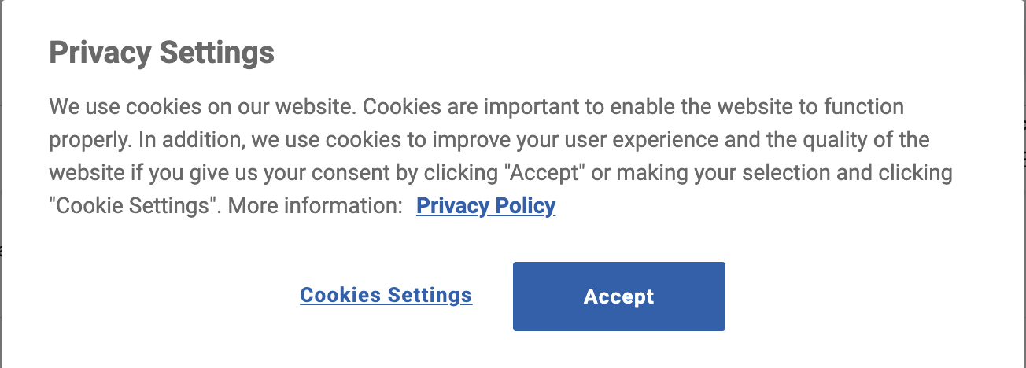
Dark Patterns : Examples

Slide 10
Dark Patterns : Examples

Slide 11
Transparency Obligations
Updated terms and conditions providing, inter alia, clear and transparent information on applicable policies, tools and procedures
Information understandable to minors (where applicable)
[online platforms]: Provision of information in a clear, concise and unambiguous manner and in real-time, where advertisements are presented to their online interface:
that the information is an advertisement;
the natural or legal person on whose behalf the advertisement is presented;
he natural or legal person who paid for the advertising;
meaningful information directly and easily accessible from the advertisement about the main parameters used to determine the recipient to whom the advertisement is presented and, where applicable, how to change those parameters.

Slide 12
Cookie Banner Checklist
Clear, accurate and specific information
Informed and explicit consent (prior to the processing)
Documenting and storing consent
Facilitating the withdrawal of consent
Not tricking the user into giving consent

Slide 13

Thank you!!

