Slide 1



Conference
Protecting Online Users: The Past, Present, and Future of Cookie Regulation
11 October 2024
Cookie Wall and Paywall
Sandra Passinhas
Data Protection Observatory
in collaboration with the
South EU Google Data Governance Chair

Slide 2
Paving the way…
Paywall
Cookie wall
The paywall is a method where the user is given another option (for example, to pay or subscribe instead of giving consent for the use of cookies) to access the content.
Freely given consent?
The cookie wall is a mechanism where the user has only one option to access the website: accept the processing of the cookies.
Refusal to deal?

Slide 3
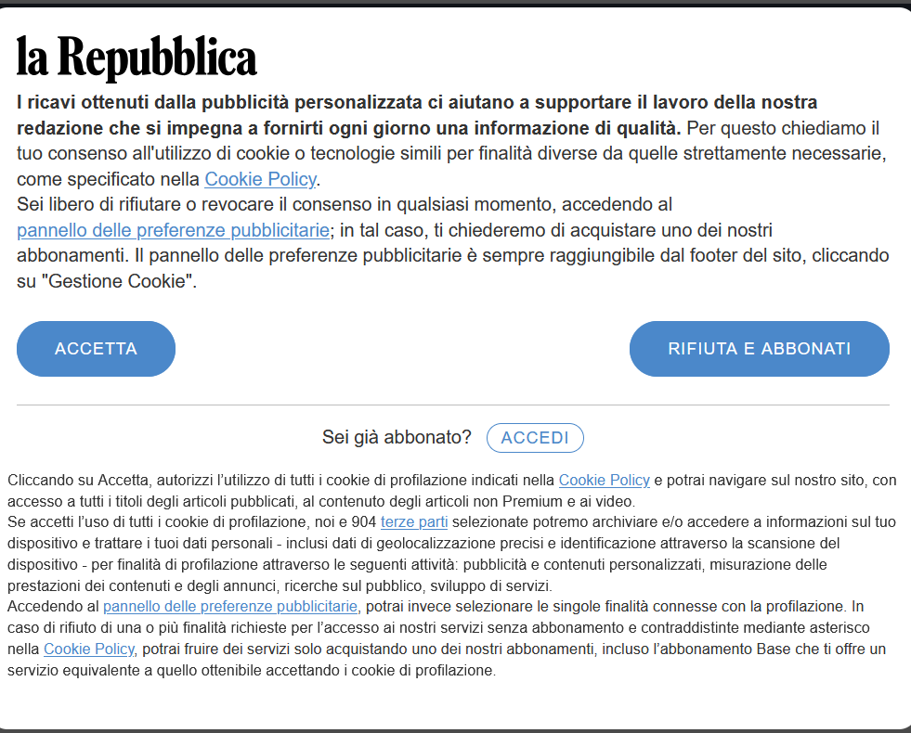

Paywall
Cookie wall

Slide 4
Pay wall
The user has an option
Agrees on it
“pay or okay” system

Slide 5
Article 5 of Directive 2002/58/EC (Directive on privacy and electronic communications)
Confidentiality of the communications
3. Member States shall ensure that the storing of information, or the gaining of access to information already stored, in the terminal equipment of a subscriber or user is only allowed on condition that the subscriber or user concerned has given his or her consent, having been provided with clear and comprehensive information, in accordance with Directive 95/46/EC, inter alia, about the purposes of the processing. This shall not prevent any technical storage or access for the sole purpose of carrying out the transmission of a communication over an electronic communications network, or as strictly necessary in order for the provider of an information society service explicitly requested by the subscriber or user to provide the service.
Notes:
Cookies that do not require consent
Consent is not necessary if the cookies are necessary for audience measurement (analytics), as long as the measurement is being done by the provider of the service requested by the end-user or by a third party on behalf of the service provider or jointly.
Consent exemption remains the same for cookies (as described in the ePrivacy Directive) that are used for security, preventing fraud, detecting incidents, or updating software (for security or fixing vulnerabilities).

Slide 6
- for the sole purpose of carrying out the transmission of a communication over an electronic communications network:
- as strictly necessary in order for the provider of an information society service explicitly requested by the subscriber or user to provide the service.
In its Opinion 04/2012, on Cookie Consent Exemption (7 June 2012), the Article 29 Working Party determined that type "A" cookies may carry out the following tasks:
Routing information over the network, e.g. by identifying communication endpoints
Exchanging data in its intended order, e.g. by numbering data packets
Detecting transmission errors or data loss
Similarly, the wording of CRITERION B suggests that the European Legislator intended to ensure that the test for qualifying for such an exemption must remain high. Following a direct reading of the directive, a cookie matching CRITERION B has to pass simultaneously the two following tests:
1) The information society service has been explicitly requested by the user: the user (or subscriber) did a positive action to request a service with a clearly defined perimeter.
2) The cookie is strictly needed to enable the information society service: if cookies are disabled, the service will not work.
Notes:
The Working Party only provides one example of a cookie that would meet these criteria: "load-balancing cookies" that persist only for the duration of a session.

Slide 7
5 Summary and guidelines
This analysis has shown that the following cookies can be exempted from informed consent under certain conditions if they are not used for additional purposes:
1) User input cookies (session-id), for the duration of a session or persistent cookies limited to a few hours in some cases.
2) Authentication cookies, used for authenticated services, for the duration of a session.
3) User centric security cookies, used to detect authentication abuses, for a limited persistent duration.
4) Multimedia content player session cookies, such as flash player cookies, for the duration of a session.
5) Load balancing session cookies, for the duration of session.
6) UI customization persistent cookies, for the duration of a session (or slightly more).
7) Third party social plug-in content sharing cookies, for logged in members of a social network.
Notes:
There is no need to obtain consent for these cookies (they can be processed on the basis of a business's "legitimate interests"), and there is no need to set up a cookie wall or even allow users to reject them.

Slide 8
Consent required - Article 4 (11) GDPR
‘consent’ of the data subject means any freely given, specific, informed and unambiguous indication of the data subject’s wishes by which he or she, by a statement or by a clear affirmative action, signifies agreement to the processing of personal data relating to him or her;
Notes:
Cookies that require consent fall into two categories:
Advertising: These cookies can be used to track users after they leave a website and create “profile” based on their online activities.
Analytics: These cookies are used to monitor how a website is used by visitors.
The Working Party specifically states that analytics cookies used for "frequency capping, financial logging, ad affiliation, click fraud detection, research and market analysis, product improvement and debugging" require consent.
Both third-party and first-party analytics cookies require consent. Although the privacy risk presented by first-party analytics cookies is relatively low, they are not used primarily for the benefit of the user and can (in theory) be used to identify individuals.

Slide 9
Judgment of the Court (Grand Chamber) of 1 October 2019, Bundesverband der Verbraucherzentralen und Verbraucherverbände - Verbraucherzentrale Bundesverband e.V. v Planet49 GmbH. Case C-673/17 [ECLI:EU:C:2019:801]
On those grounds, the Court (Grand Chamber) hereby rules:
1. Article 2(f) and of Article 5(3) of Directive 2002/58/EC of the European Parliament and of the Council of 12 July 2002 concerning the processing of personal data and the protection of privacy in the electronic communications sector (Directive on privacy and electronic communications), as amended by Directive 2009/136/EC of the European Parliament and of the Council of 25 November 2009, read in conjunction with Article 2(h) of Directive 95/46/EC of the European Parliament and of the Council of 24 October 1995 on the protection of individuals with regard to the processing of personal data and on the free movement of such data and Article 4(11) and Article 6(1)(a) of Regulation (EU) 2016/679 of the European Parliament and of the Council of 27 April 2016 on the protection of natural persons with regard to the processing of personal data and on the free movement of such data, and repealing Directive 95/46 (General Data Protection Regulation), must be interpreted as meaning that the consent referred to in those provisions is not validly constituted if, in the form of cookies, the storage of information or access to information already stored in a website user’s terminal equipment is permitted by way of a pre-checked checkbox which the user must deselect to refuse his or her consent.
2. Article 2(f) and Article 5(3) of Directive 2002/58, as amended by Directive 2009/136, read in conjunction with Article 2(h) of Directive 95/46 and Article 4(11) and Article 6(1)(a) of Regulation 2016/679, are not to be interpreted differently according to whether or not the information stored or accessed on a website user’s terminal equipment is personal data within the meaning of Directive 95/46 and Regulation 2016/679.
3. Article 5(3) of Directive 2002/58, as amended by Directive 2009/136, must be interpreted as meaning that the information that the service provider must give to a website user includes the duration of the operation of cookies and whether or not third parties may have access to those cookies.

Slide 10
Article 7 - Conditions for consent
Where processing is based on consent, the controller shall be able to demonstrate that the data subject has consented to processing of his or her personal data.
If the data subject’s consent is given in the context of a written declaration which also concerns other matters, the request for consent shall be presented in a manner which is clearly distinguishable from the other matters, in an intelligible and easily accessible form, using clear and plain language. Any part of such a declaration which constitutes an infringement of this Regulation shall not be binding.
The data subject shall have the right to withdraw his or her consent at any time. The withdrawal of consent shall not affect the lawfulness of processing based on consent before its withdrawal. Prior to giving consent, the data subject shall be informed thereof. It shall be as easy to withdraw as to give consent.
When assessing whether consent is freely given, utmost account shall be taken of whether, inter alia, the performance of a contract, including the provision of a service, is conditional on consent to the processing of personal data that is not necessary for the performance of that contract.
Notes:
A sixth condition also appears at Article 7 of the GDPR. Consent must also be:
Easy to withdraw

Slide 11
Opinion 5/2019 on the interplay between the ePrivacy Directive and the GDPR, in particular regarding the competence, tasks and powers of data protection authorities - Adopted on 12 March 2019
3.3 Matters within the material scope of both the ePrivacy Directive and the GDPR
“29. There are many examples of processing activities which trigger the material scope of both the ePrivacy Directive and the GDPR. A clear example is the use of cookies”.
Already in its opinion on online behavioral advertising, the Article 29 Working Party stated that:
“If as a result of placing and retrieving information through the cookie or similar device, the information collected can be considered personal data then, in addition to Article 5(3), Directive 95/46/EC will also apply.”
Case law of the Court of Justice of the European Union confirms that it is possible for processing to fall within the material scope of both the ePrivacy Directive and the GDPR at the same time:
Judgment of the Court (Grand Chamber) of 5 June 2018, Unabhängiges Landeszentrum für Datenschutz Schleswig-Holstein v Wirtschaftsakademie Schleswig-Holstein GmbH
Case C-210/16 [ECLI:EU:C:2018:388]
Judgment of the Court (Second Chamber) of 29 July 2019, Fashion ID GmbH & Co.KG v Verbraucherzentrale NRW eV, Case C-40/17 [ECLI:EU:C:2019:629]

Slide 12
Recital (30) of the GDPR elaborates on the definition of “online identifiers” in a way that supports the interpretation that processing of personal data may trigger the material scope of both the GDPR and the ePrivacy Directive:
“Natural persons may be associated with online identifiers provided by their devices, applications, tools and protocols, such as internet protocol addresses, cookie identifiers or other identifiers such as radio frequency identification tags. This may leave traces which, in particular when combined with unique identifiers and other information received by the servers, may be used to create profiles of the natural persons and identify them.”
Notes:
In other words, the GDPR itself explicitly refers, when clarifying its own material scope (the concept of personal data), to processing activities which also trigger, at least in part, the material scope of the ePrivacy Directive.

Slide 13
Article 95 GDPR (Recital 173)
The GDPR shall not impose additional obligations on natural or legal persons in relation to processing in connection with the provision of publicly available electronic communications services in public communication networks in the EU in relation to matters for which they are subject to specific obligations with the same objective set out in the ePrivacy Directive.
lex generalis-lex specialis relationship between the GDPR and the ePrivacy Direct
Notes:
special provisions prevail over general rules in situations which they specifically seek to regulate,
where the ePrivacy Directive “particularises” (i.e. renders more specific) the rules of the GDPR, the (specific) provisions of the ePrivacy Directive shall, as “lex specialis”, take precedence over the (more general) provisions of the GDPR.
However, any processing of personal data which is not specifically governed by the ePrivacy Directive (or for which the ePrivacy Directive does not contain a “special rule”), remains subject to the provisions of the GDPR.

Slide 14
40. A similar situation occurs with regards article 5(3) of the ePrivacy Directive, insofar as the information stored in the end-user’s device constitutes personal data. Article 5(3) of the ePrivacy Directive provides that, as a rule, prior consent is required for the storing of information, or the gaining of access to information already stored, in the terminal equipment of a subscriber or user.
To the extent that the information stored in the end-users device constitutes personal data, article 5(3) of the ePrivacy Directive shall take precedence over article 6 of the GDPR with regards to the activity of storing or gaining access to this information. The outcome is similar in the interplay between article 6 of the GDPR and articles 9 and 13 of the ePrivacy Directive. Where these articles require consent for the specific actions they describe, the controller cannot rely on the full range of possible lawful grounds provided by article 6 of the GDPR.
41. A corollary of the “lex specialis” principle is that there shall only be a derogation from the general rule insofar as the law governing a specific subject matter contains a special rule. The facts of the case must be carefully analysed to find how far the derogation extends, especially in cases where data undergoes many different kinds of processing - either in parallel or sequentially.

Slide 15
Article 6 GDPR
Processing shall be lawful only if and to the extent that at least one of the following applies:
    the data subject has given consent to the processing of his or her personal data for one or more specific purposes;
    processing is necessary for the performance of a contract to which the data subject is party or in order to take steps at the request of the data subject prior to entering into a contract;
    processing is necessary for compliance with a legal obligation to which the controller is subject;
    processing is necessary in order to protect the vital interests of the data subject or of another natural person;
    processing is necessary for the performance of a task carried out in the public interest or in the exercise of official authority vested in the controller;
    processing is necessary for the purposes of the legitimate interests pursued by the controller or by a third party, except where such interests are overridden by the interests or fundamental rights and freedoms of the data subject which require protection of personal data, in particular where the data subject is a child.
(…)

Slide 16

https://www.washingtonpost.com/gdpr-consent/
Notes:
Recent trends show an increasing number of major online services implementing a “pay or okay” policy, where users must either consent to being tracked and profiled for behavioral marketing or pay a fee to access the service. This practice has raised significant privacy concerns, leading the Data Protection Authorities (DPAs) of Norway, the Netherlands, and Hamburg to seek guidance from the European Data Protection Board (EDPB).

Slide 17
EDPB’s Opinion on “Consent or Pay” Models
Opinion 08/2024 on Valid Consent in the Context of Consent or Pay Models Implemented by Large Online Platforms
Adopted on 17 April 2024
Background
Irish Fine: Meta was fined 390 million euros by Ireland’s Data Protection Commission for issues related to its targeted advertising practices.
Meta’s Implementation Attempt: Meta introduced the “pay or OK” model on its Facebook and Instagram platforms, requiring users to either consent to targeted advertising or pay.
EDPB Binding Decision: In November 2023, the European Data Protection Board (EDPB) issued a binding decision that prohibited Meta’s targeted advertising practices across the European Economic Area, further intensifying scrutiny on how personal data is used in advertising.
Request for Formal Position: In response to the developments and ongoing concerns, the Data Protection Authorities (DPAs) of the Netherlands, Norway, and Hamburg requested the EDPB to formally address the ‘consent or pay’ models, particularly those being implemented by major platforms like Meta.
EDPB’s Significant Opinion: The EDPB released an extensive opinion on the ‘consent or pay’ models deployed by large online platforms, responding to the concerns raised by the DPAs.
Credits: https://www.iubenda.com/en/help/152202-edpbs-opinion-on-consent-or-pay-models

Slide 18
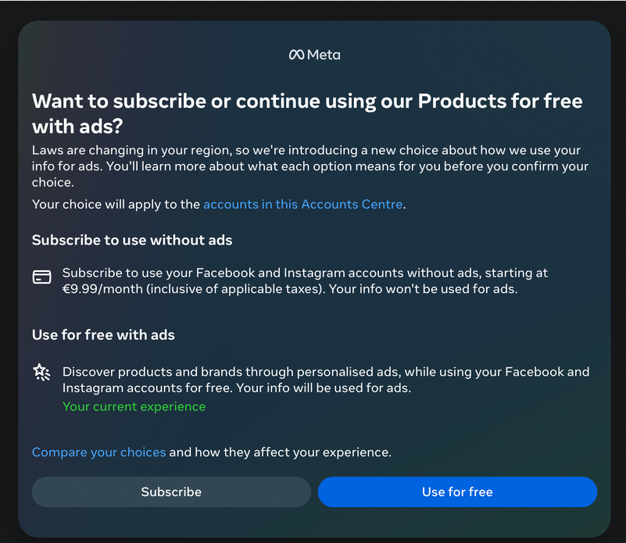

Slide 19
According to the EDPB, if users are simply given the binary option to consent to the processing of their personal data for behavioral advertising purposes or to pay a charge, then these online platforms will typically be unable to meet the conditions for valid consent.
The EDPB recommends that large online platforms should not solely rely on offering paid alternatives as the standard approach. They should consider providing an ‘equivalent alternative’ that does not require payment. If a fee is charged for accessing this alternative service, platforms must also offer another option that is free of charge.
Ideally, this free option would not include behavioral advertising; instead, it is suggested that it would include less intrusive types of advertising that process personal data in a minimum or nonexistent way.
This alternative must entail no processing for behavioural advertising purposes and may for example be a version of the service with a different form of advertising involving the processing of less (or no) personal data, e.g. contextual or general advertising or advertising based on topics the data subject selected from a list of topics of interests.

Slide 20
EDPB Proposal
Accept All: this includes also consenting to processing of data for behavioural advertising
Accept with Non-Behavioral Advertising: Consent without behavioral tracking
Pay: Access with a fee without personal data being processed for for behavioural advertising purposes.
Notes:
In essence, this could imply providing users with three options rather than the limited binary choice

Slide 21
Article 7 (4) RGPD
This view is supported by Recital 42 of the GDPR, which states:
"Consent should not be regarded as freely given if the data subject has no genuine or free choice or is unable to refuse or withdraw consent without detriment."
When assessing whether consent is freely given, utmost account shall be taken of whether, inter alia, the performance of a contract, including the provision of a service, is conditional on consent to the processing of personal data that is not necessary for the performance of that contract.
Notes:
The debate centers on the voluntary nature of consent and the conditions under which it is obtained, especially in light of the EU Court’s emphasis on the voluntary aspect of consent. The EDPB is advocating for a third option that promotes fairness and choice for users. This push for an alternative approach aims to clarify the legality and ethics of ‘pay or okay’ models across European DPAs, potentially reshaping practices in popular online services
the need for transparent and less invasive marketing practices remains, underscoring the balance between profit maximization and respecting user privacy.

Slide 22
Assessing valid consent
The EDPB indicated that the following criteria ought to be considered when determining valid consent:
Conditionality: Controllers need to make sure that all the requirements to freely given and valid consent are met. The legitimacy of consent on a case-by-case basis must be carried out.
Detriment: Controllers cannot impose conditions that harm data subjects for not consenting, leading to restrictions of access to services, professional networks, or content.
Imbalance of Power: Controllers must assess market dominance, lock-in effects, dependency levels, and audience characteristics to avoid power imbalances.
Granularity: Data subjects should be able to give consent for distinct processing activities.

Slide 23
making privacy a key part of the user experience on all digital platforms,
fostering a more equitable digital environment.
Notes:
The Opinion mainly focuses on large online platforms but also seems to sets a general standard that could apply to various digital services,

Slide 24
Cookie wall
Agree to cookies
Leave the website
Notes:
If there is no alternative way for visitors to access content on a website without accepting cookies, then blocking them from accessing the site is unfair

Slide 25
Guidelines 05/2020 on consent under Regulation 2016/679 Version 1.1
Adopted on 4 May 2020
39. In order for consent to be freely given, access to services and functionalities must not be made conditional on the consent of a user to the storing of information, or gaining of access to information already stored, in the terminal equipment of a user (so called cookie walls).
40. Example 6a: A website provider puts into place a script that will block content from being visible except for a request to accept cookies and the information about which cookies are being set and for what purposes data will be processed. There is no possibility to access the content without clicking on the “Accept cookies” button. Since the data subject is not presented with a genuine choice, its consent is not freely given.
41. This does not constitute valid consent, as the provision of the service relies on the data subject clicking
the “Accept cookies” button. It is not presented with a genuine choice.
Notes:
On 10 April 2018 the Article 29 Working Party adopted its Guidelines on consent under Regulation
2016/679 (WP259.01), which were endorsed by the European Data Protection Board (hereinafter
“EDPB”) at its first Plenary meeting. This document is a slightly updated version of those Guidelines.
Any reference to the WP29 Guidelines on consent (WP259 rev.01) should from now on be interpreted
as a reference to these guidelines

Slide 26
Data Protection Agencies…
The Spanish DPA indirectly shared its position implying that cookie walls can be used as long as the user has been clearly informed of the two available options for accessing the service:
accepting the use of cookies; or
another alternative, “not necessarily free of charge“, that doesn’t require giving consent to cookies.
The Italian DPA (Garante Privacy) stated in its latest Guidelines on cookies and other tracking tools that the cookie wall is unlawful except when the website provides the data subject with the option of accessing equivalent content or services without giving his or her consent to the storage and use of cookies or other tracking tools – which will have to be verified on a case-by-case basis.

Slide 27
Drafts of the ePrivacy Regulation
In a May 2018 draft of the regulations, it was proposed that websites could make access to “specific website content” conditional on consent.
In February 2019, this proposal was amended to allow so-called "cookie paywalls," which offer payment as an alternative to consent.
The EDPB recommended in 2019 that the ePrivacy Regulation should prohibit the use of cookie walls.
Notes:
The rules on cookie walls have been amended several times throughout drafts of the ePrivacy Regulation.

Slide 28
Directive 2005/29/EC of the European Parliament and of the Council of 11 May 2005, concerning unfair business-to-consumer commercial practices in the internal market (‘Unfair Commercial Practices Directive’)
Article 2, d): business-to-consumer commercial practices’ (hereinafter also referred to as commercial practices) means any act, omission, course of conduct or representation, commercial communication including advertising and marketing, by a trader, directly connected with the promotion, sale or supply of a product to consumers;
Article 5, §1: Unfair commercial practices shall be prohibited.

Slide 29
Article 8 - Aggressive commercial practices
A commercial practice shall be regarded as aggressive if, in its factual context, taking account of all its features and circumstances, by harassment, coercion, including the use of physical force, or undue influence, it significantly impairs or is likely to significantly impair the average consumer's freedom of choice or conduct with regard to the product and thereby causes him or is likely to cause him to take a transactional decision that he would not have taken otherwise.

Slide 30
Article 3 (j) ‘undue influence’ means exploiting a position of power in relation to the consumer so as to apply pressure, even without using or threatening to use physical force, in a way which significantly limits the consumer’s ability to make an informed decision;

Slide 31
Article 9 - Use of harassment, coercion and undue influence
In determining whether a commercial practice uses harassment, coercion, including the use of physical force, or undue influence, account shall be taken of:
a) its timing, location, nature or persistence;
b) the use of threatening or abusive language or behaviour
c) the exploitation by the trader of any specific misfortune or circumstance of such gravity as to impair the consumer's judgement, of which the trader is aware, to influence the consumer's decision with regard to the product;
d) any onerous or disproportionate non-contractual barriers imposed by the trader where a consumer wishes to exercise rights under the contract, including rights to terminate a contract or to switch to another product or another trader;
e) any threat to take any action that cannot legally be taken.

Slide 32
General clause of Article 5
2. A commercial practice shall be unfair if:
(a) it is contrary to the requirements of professional diligence,
and
(b) it materially distorts or is likely to materially distort the economic behaviour with regard to the product of the average consumer whom it reaches or to whom it is addressed, or of the average member of the group when a commercial practice is directed to a particular group of consumers.
to materially distort the economic behaviour of consumers’ means using a commercial practice to appreciably impair the consumer’s ability to make an informed decision, thereby causing the consumer to take a transactional decision that he would not have taken otherwise

Slide 33
Article 3, k): ‘transactional decision’ means any decision taken by a consumer concerning whether, how and on what terms to purchase, make payment in whole or in part for, retain or dispose of a product or to exercise a contractual right in relation to the product, whether the consumer decides to act or to refrain from acting;

Slide 34
Article 11a - Redress
1. Consumers harmed by unfair commercial practices, shall have access to proportionate and effective remedies, including compensation for damage suffered by the consumer and, where relevant, a price reduction or the termination of the contract. Member States may determine the conditions for the application and effects of those remedies. Member States may take into account, where appropriate, the gravity and nature of the unfair commercial practice, the damage suffered by the consumer and other relevant circumstances.
2. Those remedies shall be without prejudice to the application of other remedies available to consumers under Union or national law.

Slide 35
Thank you!
sandrap@fd.uc.pt
Associate Professor of the Faculty of Law of the University of Coimbra
Portuguese member of the DSA Committee
Portuguese Member of the European Digital Services Expert Group
Executve Director of the Research Center on Consumer Law (Faculty of Law of the University of Coimbra)

