Slide 1

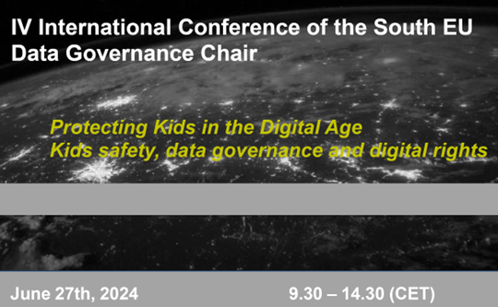
Kids & Internet gambling:
The problem of age verification
Georgios N. Yannopoulos
Associate Professor, School of Law,
National & Kapodistrian University of Athens
Director, Laboratory of Law & Informatics
gyannop@law.uoa.gr

Slide 2

No minor should be able to play on a gambling website or hold a player account
EU Rec (2014) art. 8
One of the most important rules for weak / vulnerable groups
EU: No common age (18 or 21?)
  Harmful behavior → worse in minors
  More risky /”masculine” activities
  Increased depression & suicide rates

Slide 3
EU Rec art. 9 → Member States should ensure that the operator has procedures in place designed to prevent minors from gambling, including age verification checks during the registration procedure
No minor should be able to play on a gambling website or hold a player account
EU Rec (2014) art. 8
GDPR AGE OF CONSENT (CPDP 2022)
controllers will be expected to make reasonable efforts to verify that the user is over the age of digital consent, and these measures should be proportionate to the nature and risks of the processing activities – appropriate checks
(EDPB Guidelines 05/2020, §§ 138-142 – Example No. 23 (gaming))

Slide 4
Links to parental control programmes (art. 10)
NOT to show / view gambling as a natural element of their leisure time (art. 11).
“no underage gambling” clear message indicating the minimum age (art. 12)
No broadcasting (art. 13)
a) when minors are the main audience;
b) on websites with minors as the audience profile;
c) in close proximity of places (schools).
Obligations for advertisement to minors

Slide 5
NO (art. 14):
a) exploitation of the inexperience or lack of knowledge,
b) use of images of minors or young persons,
c) association of gambling with youth culture activities,
d) suggestion that to gamble marks the transition from adolescence to adulthood
Restrictions for content

Slide 6
Analog v digital methods: “creating an account”
Yet: “Targeting” under restrictions (&GDPR)
Transborder verification. Providers:
Decline those not originating from the country of license or
verify according to national rules or
use double check: accepts registration according to national rules but also with the country of origin
Implementation mechanisms

Slide 7
Verification subject to data trustworthiness
  Facial recognition
  mass collection of data
  circumventions? e.g. declaration by kids or using an adult’s credit card
Use of scanned documents or
Documents verified by trusted third party (e.g. tax authority, citizens’ number etc)
Verification problems

Slide 8
Providers liable to verify (see DSA)
  “know your audience” / “your platform – your responsibility”
Use of credit / debit cards
Comparison with consumers’ database / credit agencies
Mystery shoppers
Reliable methods can have faults (e.g. case of Dutch surnames)
Not reliable methods
PROPOSALS:
Two step? Official ID?
Out–of-the-wallet practice (OOW – questions)
Credit card ? Small transaction? (COPPA, FTC)
Electronic signatures?
Biometric?
In-app-button (tik-tok)

Slide 9

Más sabe el diablo por viejo que por diablo
Bypassing age verification →
No magic solution

