Slide 1


Conference
Protecting Online Users: The Past, Present, and Future of Cookie Regulation
Ilda Botelho de Sousa
11 October 2024 | NOVA School of Law | hybrid format

Slide 2

About us
A portuguese based association of professionals, so this is the target audience for our activities.
Our mission is training and awareness-raising as a way to qualify our members about Data Protection and Cibersecurity. We have partnerships with educational institutions and others to strengthen our members’ skills.
Provide professionals with up-to-date real information and the best knowledge.

Slide 3





Our activities and work
Training
Workshops
Professional meetings
Professional opinions

Slide 4
Current PT Cookies landscape
Waiting for our DPA (CNPD) to issue its recommendations/guidelines on cookies (expected as early as 2021)…
A great number of SME’s websites in PT still not comply with E-privacy Diretive and GDPR obligations and also don’t respect users privacy.
In the absence of opinion from our DPA, APDPO recommends that:
non-essential cookies must require users consent - informed and truly free. GDPR must apply to this matter.
Companies must inform users with cookies policies (cookies notice).

Slide 5

APDPO opinion on the ePrivacy Regulation
APDPO does not agree with the European Commission's proposal in the ePrivacy Regulation on ‘simplifying consent for cookies’ and the fact that the proposal no longer requires consent for certain intrusive ‘non-privacy’ cookies that improve the internet experience, such as ‘shopping-cart history’ and those for counting web visitors.
But we agree on a rule more user-friendly as browser settings that can provide easy ways to accept or refuse tracking cookies and other identifiers, to combat “consent fatigue”.
.

Slide 6
APDPO opinion on the ePrivacy Regulation
APDPO also defends the same as EPDB's position (Statement 3/2021 of 9/march) :
  there should continue to be the freedom to consent or not to cookie walls,
  browsers and operating systems must put in place user-friendly mechanisms allowing controllers to obtain consent, to create a level playing field between all actors, and the scope of the Regulation should also explicitly include browser and operating system providers.
  Privacy settings should preserve the right to the protection of personal data and the integrity of terminals of users by default and should facilitate expressing and withdrawing consent in an easy, binding and enforceable manner against all parties
  the Regulation must respect the GDPR by requiring consent for all cookies.

Slide 7
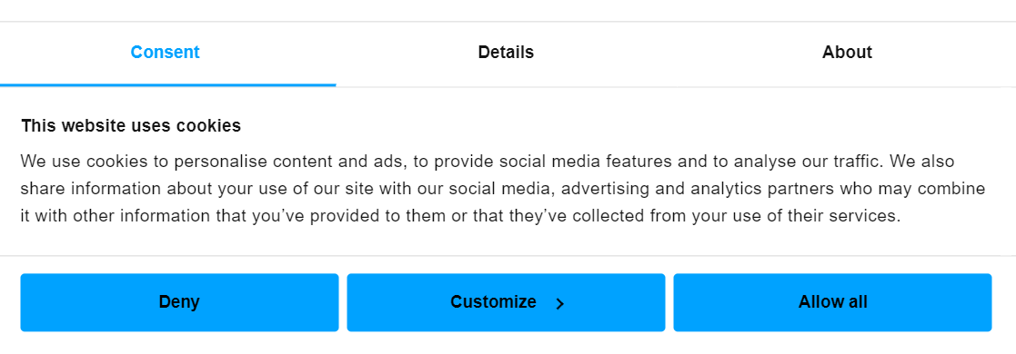
Cookie consent management

Slide 8
No news, old news? Comply to…?
While we wait on the ePrivacy Regulation, hoping on good news for protecting users privacy regarding the tracking of online activities, we are left to:
The “old” ePrivacy Directive
The useful EPDB guidelines
The CJEU decisions
The adoption of cookie consent managers (based in the EU) fulfilling a truly free and informed consent.
And of course, GDPR – free and inform consent and cookies policy

Slide 9
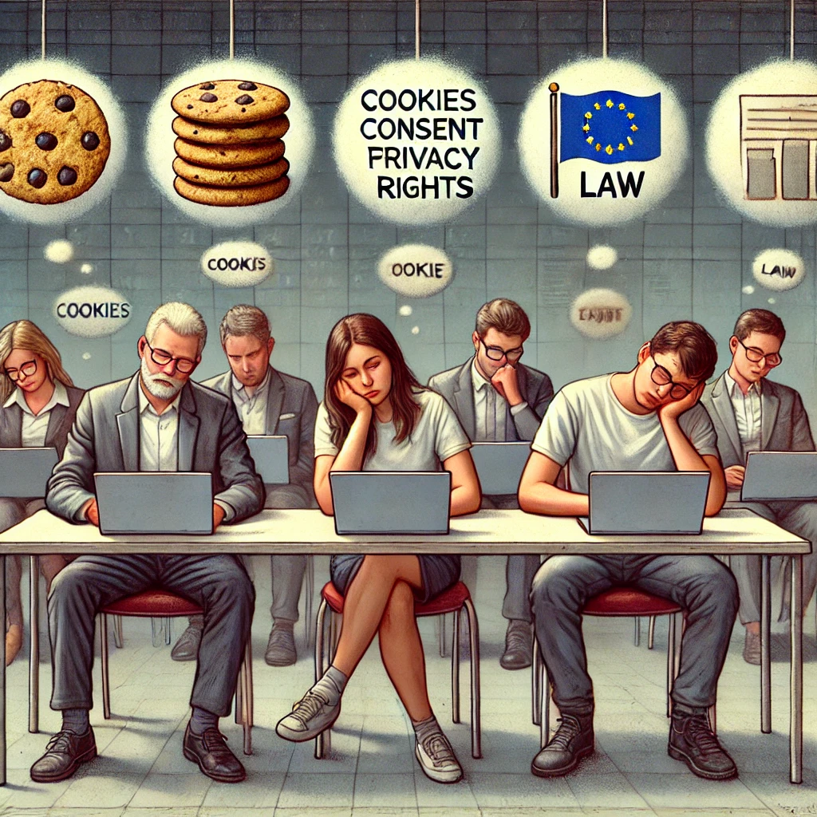
The present…
Image generated with Dalle.
Prompt: “Regenerate the image with all the users on their computers, and informal dressed... web cookies fatigue and looking at a Regulation that for now is just a dream and not reality…”

Slide 10

Privacy builds trust
THANK YOU
https://www.dpo-portugal.pt/

