Slide 1

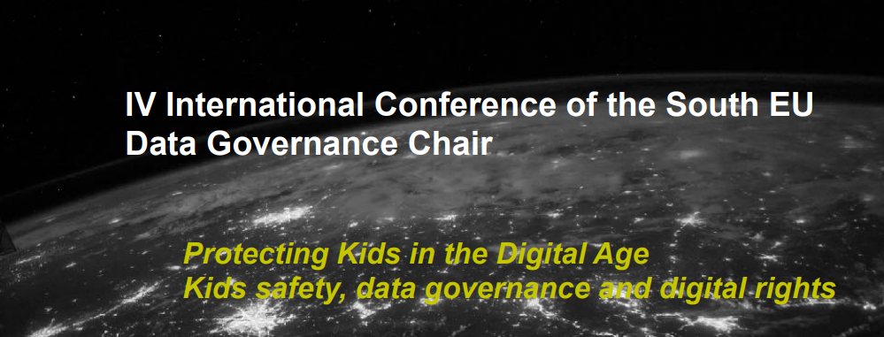




From Ultrasounds to Artificial Intelligence:
How to Protect Children's Data?
Tito de Morais & Cristiane Miranda
A joint projet:

Slide 2


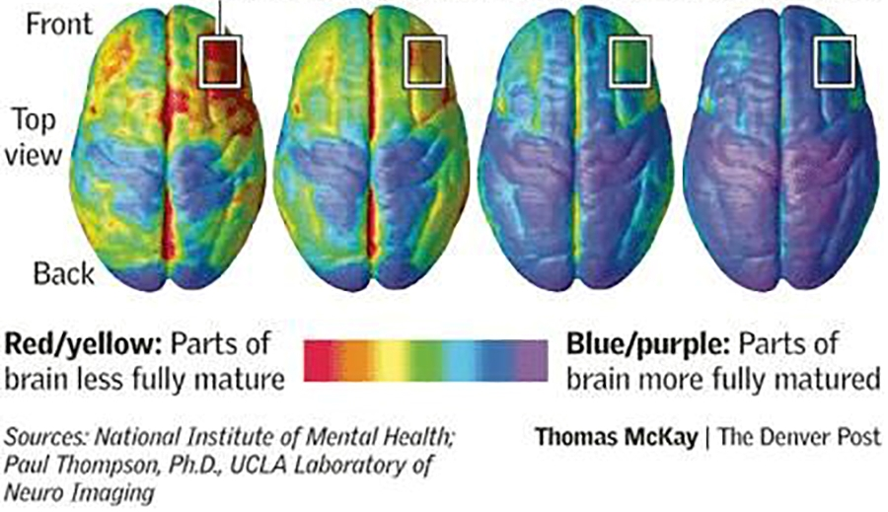
Brain Development
Brain: 5 year-old pre-teen teenager 20 year-old
Pre-frontal cortex

Slide 3
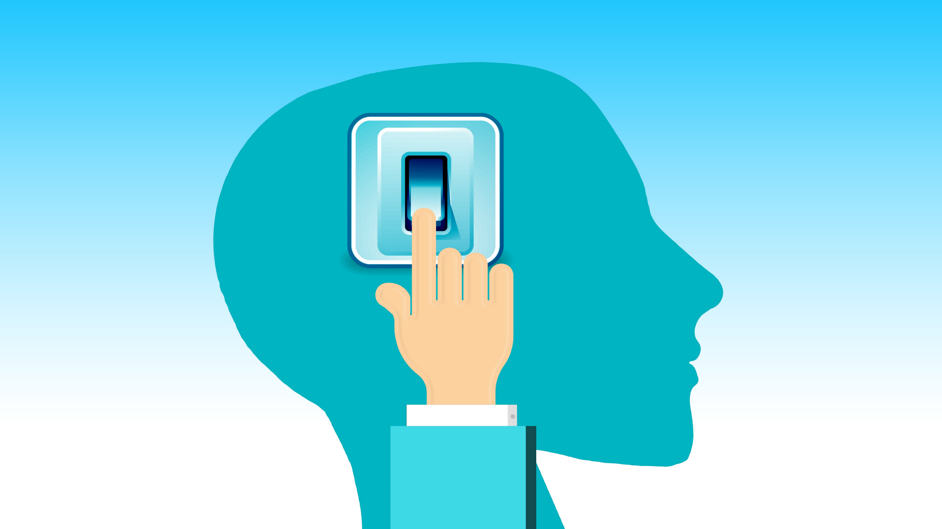
The Attention Economy

Slide 4
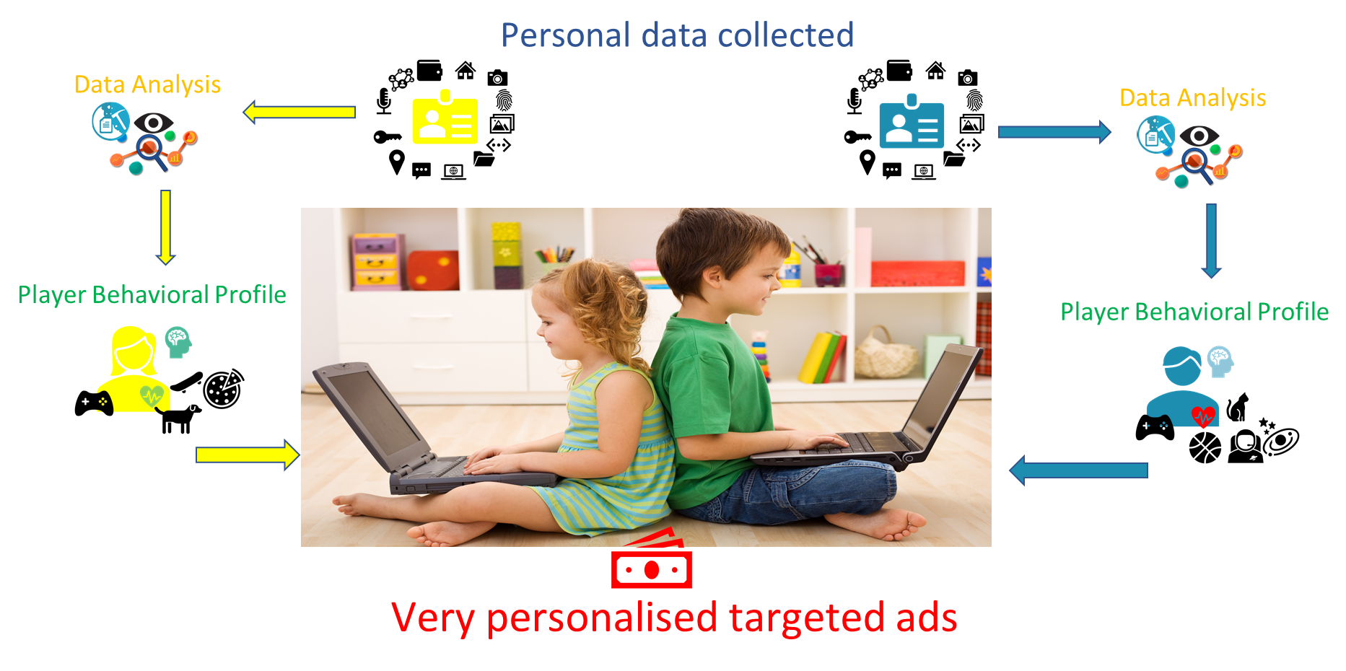
How Dark Patterns Work

Slide 5
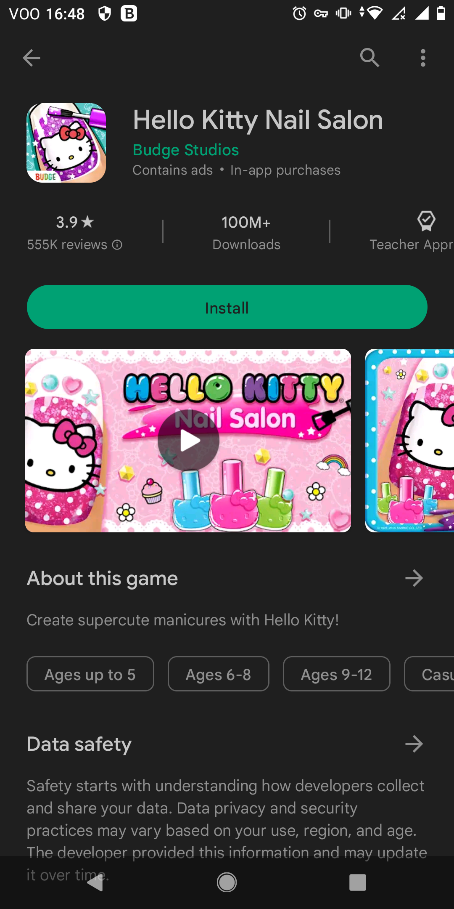
How Dark Patterns Affect Children
Children chooses the age bracket that they want!
Risk: monetization schemes based on targeted advertising; in-game purchases
Budge Studios. 2023. Hello Kitty Nail Salon, Google Play Store.

Slide 6

Lootboxes
The loot box encourages spending real money in in-game content through a reward system (gambling, casino)
NCC INSERT COIN: ‘’How the gaming industry exploits consumers using loot boxes” https://storage02.forbrukerradet.no/media/2022/05/2022-05-31-insert-coin-publish.pdf

Slide 7


Autoplay & Infinite Scroll
Autoplay and infinite scrolling features on social media, prolongs engagement, keeping children hooked on the content… and not sleeping so much!

Slide 8
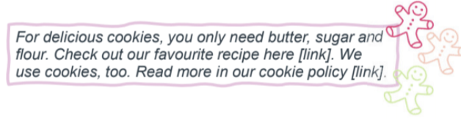
Cookies

Slide 9

Geolocation
The platform asks to share user’s geolocation by stating:
“Hey, a lone wolf, are you? But sharing and connecting with others help make the world a better place! Share your geolocation! Let the places and people around you inspire you!”

Slide 10
Harms Caused by Dark Patterns
Individual welfare:
Autonomy
Labor and cognitive burdens
Phychological
  emotional distress
  addiction
  irritation, disengagement
Privacy
Trust
Discrimination
Attention
Collective welfare: detrimental effects on
competition
price transparency
trust in the market
Financial loss
Physical harm
Time
Mathur M, Mayer J, Kshirsagar M (2021). What Makes a Dark Pattern... Dark?: Design Attributes, Normative Considerations, and Measurement Methods. In CHI Conference on Human Factors in Computing Systems

Slide 11
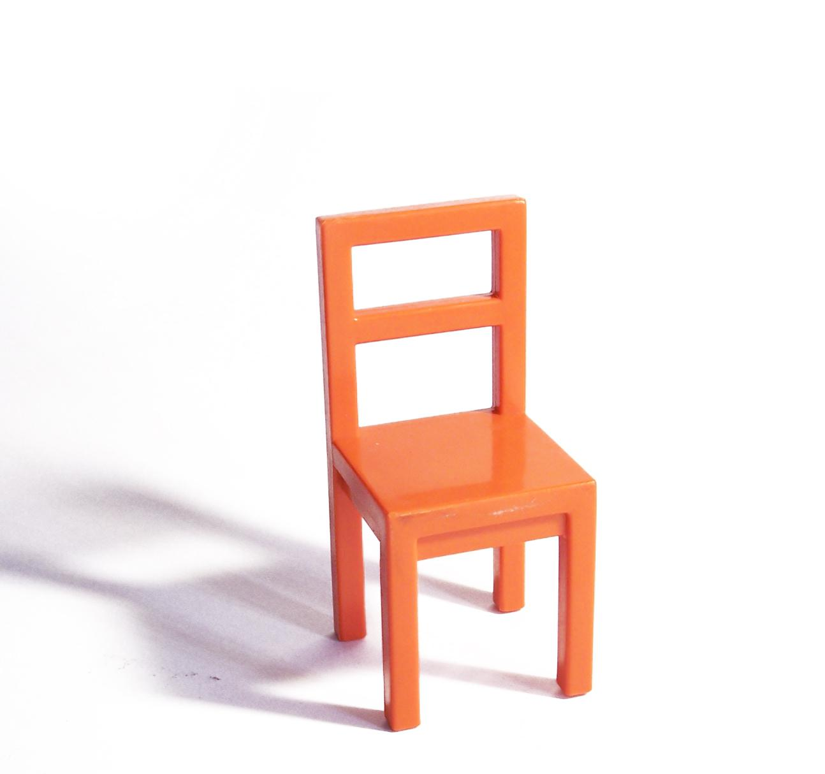
Solutions: Online Safety
Regulatory
Parental
Educational
Technological

Slide 12
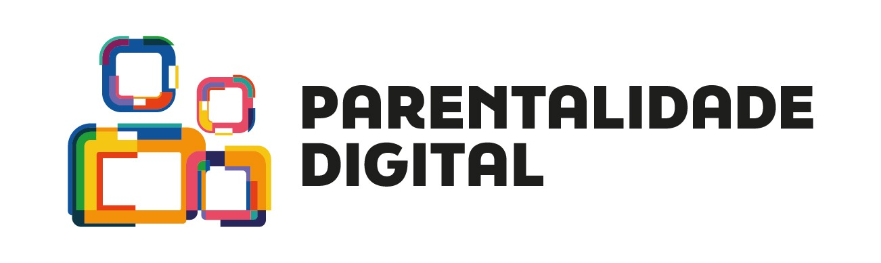

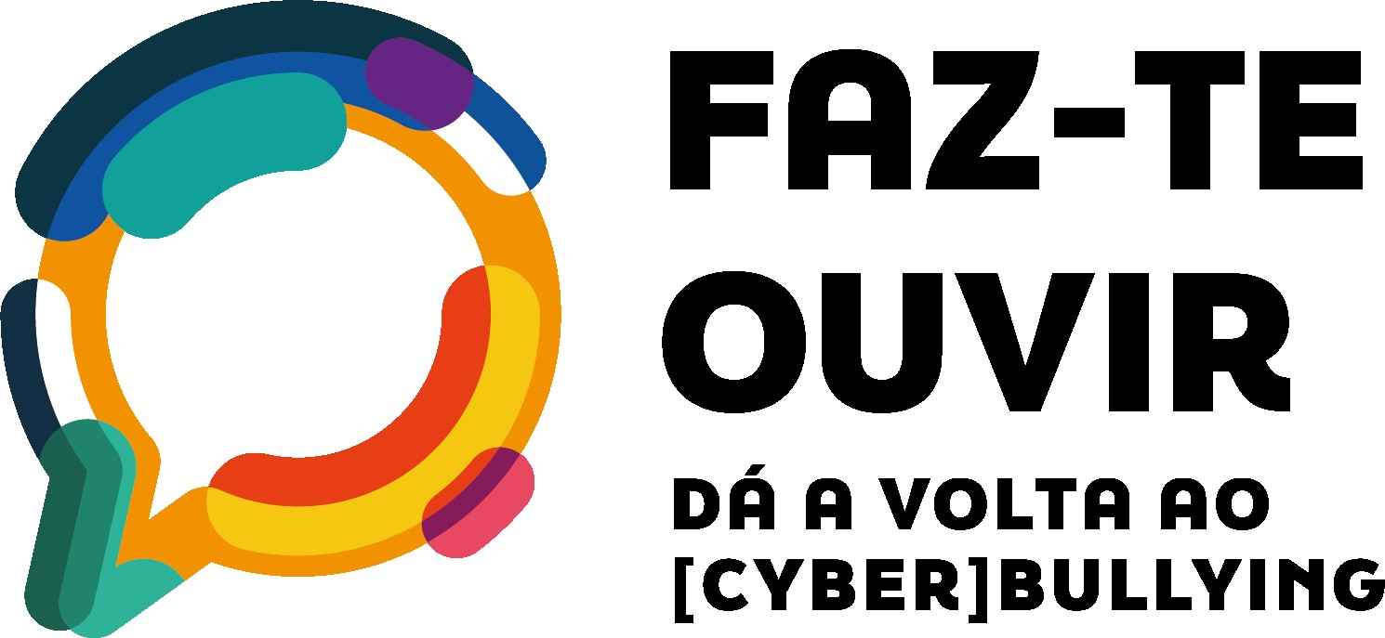


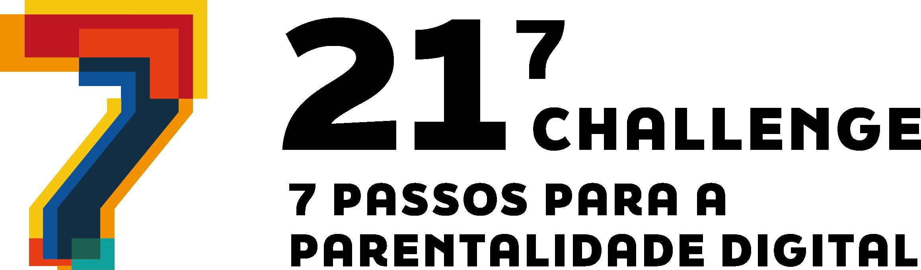
Areas of Work
Prevention of excessive or problematic use of screens
Prevention and tackling [cyber]bullying
Reduction of the negative impacts of social media in body image
Prevention of image based sexual violence, from online grooming to non-consensual sharing of intimate content, including online sexual coercion and sextorsion
Prevention of dangerous viral challenges
Reduction of the negative impacts of the digital footprint
SCHOOL
TOUR

Slide 13




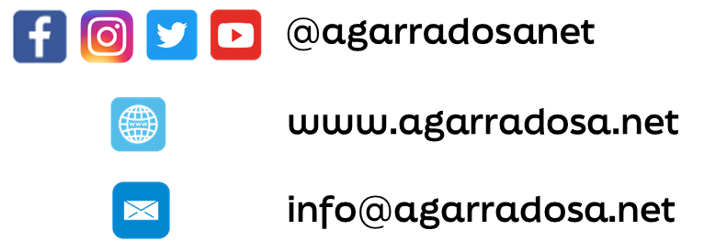
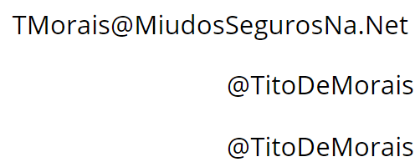

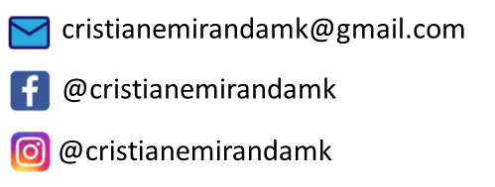
Follow us on social media.

