Slide 1
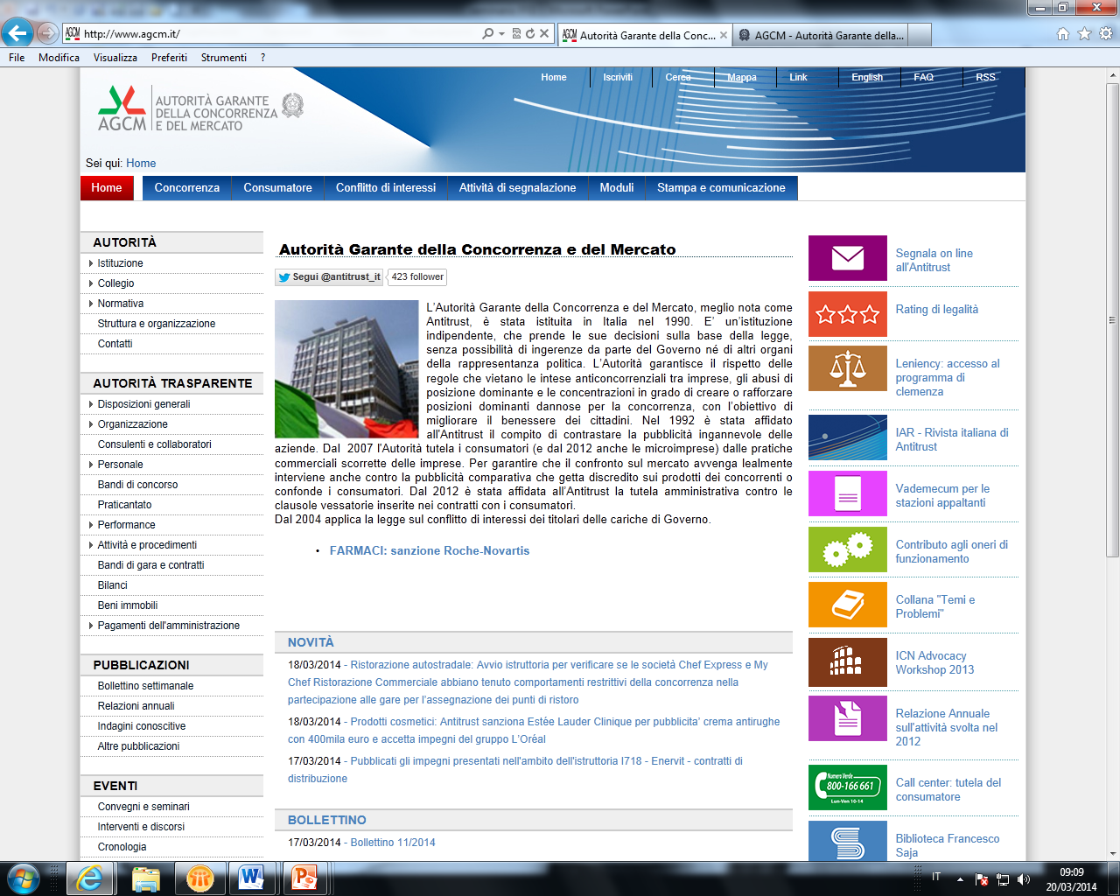
The future of consumer profiling and of commercial communications
Rome – April 22, 2024
Giovanni Calabrò
Chief of Staff of the Italian Competition Authority

Slide 2
Abstract
Introduction: the use of consumers’ data
1. Data-driven zero-price markets
2. Consumer profiling and commercial communications
Conclusions

Slide 3
Introduction
Corporate conduct involving the collection, use and disclosure of users’ data are increasingly an object of concern → high risks in case of significant information asymmetries between market players and users
This can be achieved also through consumer protection legislation
No ban on data collection and exploitation
Ensure consumers’ free choice on how to use their data
Also pro-competitive role: companies compete for quality in terms of privacy
2019 joint sector inquiry AGCM, AGCOM, Privacy Authorities
reducing of info asymmetries: fundamental policy objective
consumers should be fully informed as to how their data will be used and about the need to transfer such data for the viability of the provided service

Slide 4
1. Data-driven zero-price markets and consumer protection […]
In this context, users are attracted by claims that the service offered is free
The economic returns pursued by companies, which can exploit data to the maximum extent through user profiling, are not clearly disclosed
In Italy, the Authority held that even in the context of such an offer, of a 'free' service, a B2C relationship exists, since gratuitousness is only apparent
Main cases
WhatsApp (2017): consumers forced to accept the application's new Terms of Use → otherwise no possibility to use the service
Facebook (2018): consumers induced to register on the platform, by not informing them adequately and immediately of data collection activity
Google (2021): the company did not provide clear and immediate information on the acquisition and use of user data for commercial purposes
adopted before the “Omnibus” Directive → the Consumer Rights Directive also applies to free digital services

Slide 5
1. […] Data-driven zero-price markets and consumer protection
This area is paradigmatic of the effectiveness of the two competences of the Authority, competition and consumer protection
Also antitrust investigations against possible abusive conduct of large platforms in data acquisition and sharing with third-party operators
Main cases
Google: investigation concerning the platform's conducts regarding data portability, closed by accepting commitments to ensure the automatism of data export from Google to other parties (2023)
Apple: concerning a more restrictive privacy policy adopted for third-party app developers and the fact that developers and advertisers would allegedly be penalized in terms of the quality of the data made available (opened in 2023, pending)

Slide 6
2. Consumer profiling and commercial communications […]
Not a new phenomenon
However, consumers’ negative sentiment: 75% of people in the EU; similar findings in the US
Considerations of fairness
Apprehension about the collection and processing of personal data and the overall lack of transparency of automated pricing algorithms
Normative definition not in consumer laws but in the GDPR and in the DMA
Profiling: “any form of automated processing of personal data consisting of the use of personal data to evaluate certain personal aspects relating to a natural person, in particular, to analyse or predict aspects concerning that natural person’s performance at work, economic situation, health, personal preferences, interests, reliability, behaviour, location or movements” (art. 4 GDPR)

Slide 7
2. […] Pros and cons
Profiling could in some instances prove beneficial for consumers
May ensure that consumers are only exposed to relevant commercial solicitations and receive offers which are more likely to match
In some sectors, efficiency-enhancing effects
These examples underline the need for a more nuanced and liberal approach to consumer profiling, as a blanket prohibition is probably not warranted
E.g. in industries with high fixed and low marginal costs (hospitality, entertainment, air transport etc.) sold quantities could expand inasmuch as consumers could afford otherwise inaccessible goods
However, undertakings could also try and differentiate the products, to lure consumers with higher willingness to pay (e.g. premium seats, luxury rooms) → may be inimical to consumer welfare

Slide 8
2. […] Pros and cons
Legitimate concerns are more likely to arise when competition is already dampened or consumers are unaware of profiling
More sophisticated profiling techniques involve complex data protection issues and are indeed problematic; even rough segmentations based on age, location, gender or device could adversely affect consumers
Some forms of discrimination are prohibited outright by the constitutional principle of equality, including on the basis of racial or ethnic origin, and sex;
The geo-blocking regulation 2018/302/EU prohibits online sales discrimination based on customers' nationality, place of residence or of establishment
When profiling-based personalisation is not per se illegal, transparency is crucial for consumers to make informed market choices

Slide 9
2. […] Legislative reference
See for instance:
Recital 45 of Directive 2019/2161/EU, amending the Consumer Rights Directive: “traders may personalise the price of their offers for specific consumers or specific categories […] Consumers should therefore be clearly informed”
Article 15 of the DMA, providing that gatekeepers submit an independently audited description of any techniques for profiling of consumers
The latest comprehensive survey run by the European Commission failed to observe a consistent and systematic pattern of price personalisation
Mystery shopping exercises identified consistent instances of price personalisation in the hotel booking and airline industries

Slide 10
2. […] Italy: Authority’s practice
In Italy, the Authority has analysed selective offers in mobile telecom markets:
consumers switching to new entrants would be targeted by former providers through win-back strategies (higher price-sensitivity vis-à-vis other clients). These practices gave rise to competition concerns → advocacy intervention prompted a legislative reform.
More recently, the Authority received a complaint about an alleged price discrimination strategy implemented by a low-cost air carrier, which would apply different fees for carry-on luggage according to the device consumers used to log on on the internet
→ it emerged to be a behavioural test (unbeknown to consumers)

Slide 11
2. […] EU: Commission’s practice
On 7 March 2024, the European Commission and national consumer authorities wrapped up a coordinated action against Tinder
In summer 2022, intervention against undisclosed price personalisation techniques of Wish, lead the company to choosing to discontinue the conduct
Tinder offered personalised automated discounts for access to its premium services, without informing consumers; until 2022 Tinder also used to offer lower prices based on consumers’ age
Tinder committed to:
not applying personalised pricing based on age without informing consumers clearly and upfront;
informing consumers that discount on prices for premium services are personalised using automated means and why consumers are offered personalised discounts

Slide 12
Conclusion: all in all […]
Disclosing relevant information may increase consumer acceptance of profiling techniques, and address most sources of consumer detriment
However, economic theory suggests that welfare implications of commercial offers’ personalisation may prove ambiguous even in such cases
From a competition perspective, it may lead to a severe obfuscation of benchmark prices, making it more difficult for consumers to compare available alternatives;
If based on expected willingness to pay, it may amplify the vulnerability of consumers with fewer choices (e.g. because of their age, credit history, etc.).
In extreme cases, some (groups of) consumers may be prevented from purchasing some goods or services, which become unaffordable →negative in terms of societal inclusion and cohesion

Slide 13
[…] Conclusion: all in all
From the consumer legislation standpoint, exploitation of consumer vulnerability through personalised pricing may fall under Directive 2005/29/EC: possible breach of professional diligence and adverse impact on the economic behaviour of consumers → unfair commercial practice!
However, no need to introduce a blanket ban: welfare impact will need to be assessed in the specific circumstances of each case
E.g. flights to Sicily and Sardinia: when they spiked in summer 2023, the Italian Government introduced a ban on automated dynamic pricing (no evidence of personalisation) → strong criticism on efficiency grounds
Consumer protection authorities are well-equipped!
Their investigative powers allow for full access to the methodologies used by undertakings to acquire consumer data and devise pricing strategies, as well as to impose specific transparency obligations, with a view to ensuring the fairness of behavioural personalisation

Slide 14
Thanks for your attention!

